Slide 1
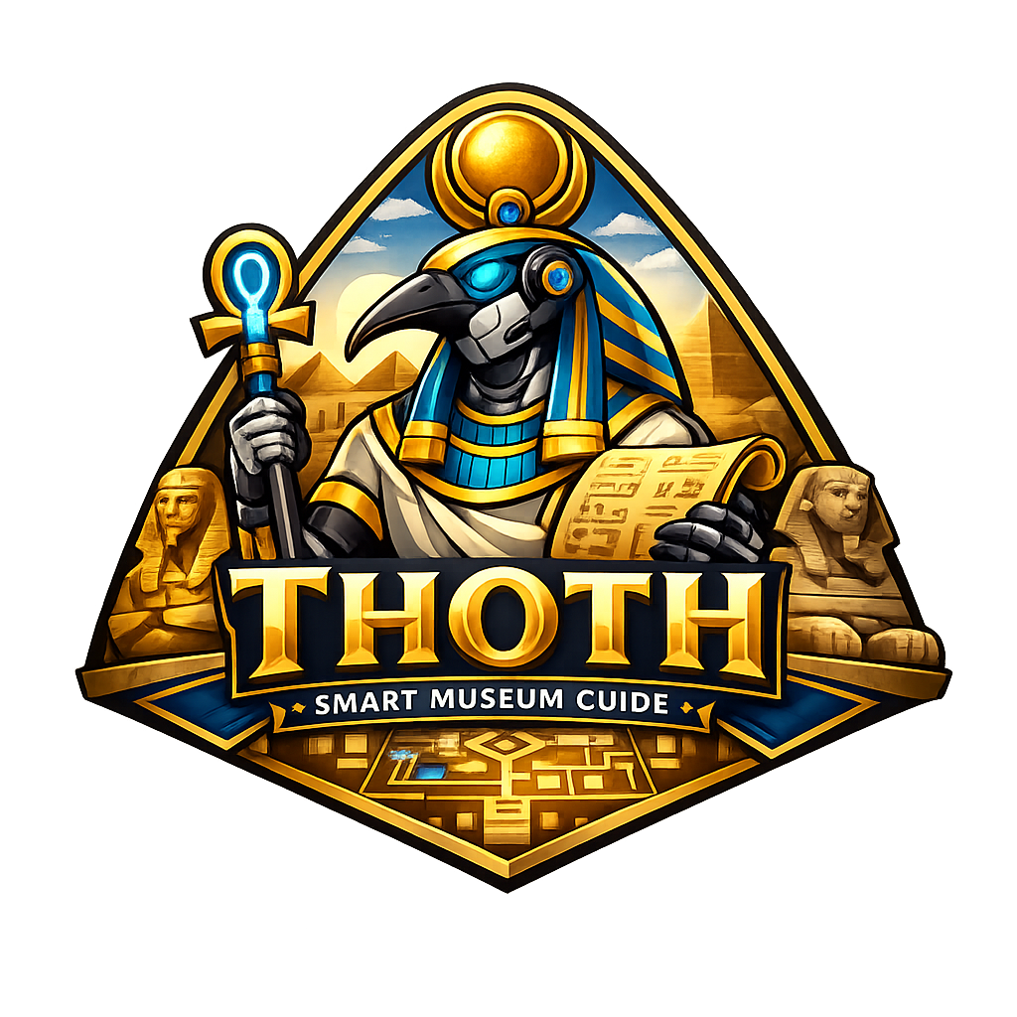
THOTH
Smart Museum Guide Robot
Graduation Project I — Final Presentation
Computer Engineering Department · AASTMT
Supervised by Dr. Marwa Elshenawy · Dr. Mohamed Elhabrouk
Presented by Leena Gouda – Nayrouz Ahmed – Habiba Ghoneim – Youssef Waleed – Saged Khaled – Mohamed Eldairouty
2026 - 2027
THOTH — Smart Museum Guide
01 / 00

Slide 2
07
Business Model
THOTH — Smart Museum Guide
28 / 00

Slide 3
Business Model
● KEY PARTNERS
• AASTMT University
• Grand Egyptian Museum (GEM)
• Ministry of Tourism & Antiquities
• AI/Cloud providers (OpenAI, Google)
• Hardware suppliers (NVIDIA, RPLiDAR)
• System integrators & venues
• Egypt Vision 2030 initiatives
● KEY ACTIVITIES
• Robot R&D, SLAM & Nav2 development
• LLM + STT/TTS integration & tuning
• GUI/UX design & touchscreen app
• Exhibit content curation per venue
• Pilot deployment & on-site testing
● VALUE PROPOSITIONS
• Autonomous indoor navigation (Nav2)
• Always-on multilingual guide (AR/EN/FR)
• Free-form LLM conversation
• Adapts to visitor age & mood (CV)
• Multimedia exhibit display (video/images)
• Accessibility: captions, RTL, large fonts
• Scalable to airports, hospitals, expos
• Real-time visitor analytics dashboard
● CUSTOMER RELATIONSHIPS
• GEM pilot deployment & live demos
• Dedicated maintenance & support SLAs
• Visitor analytics reports to management
• Onboarding & staff training per venue
● CUSTOMER SEGMENTS
• Museums & heritage sites (primary: GEM)
• International & foreign tourists
• Airports & metro stations
• Academic & medical campuses
• Expos, malls & smart-city installations
• Visitors w/ hearing impairments
● KEY RESOURCES
• NVIDIA Jetson Orin Nano (edge AI)
• RPLiDAR A2/A3 + OAK-D depth camera
• ROS2 + Nav2 + Gazebo + RViz stack
• Whisper STT + ElevenLabs TTS + LLM
• 6-member multidisciplinary eng. team
● CHANNELS
• Government & tourism partnerships
• Tech expos & trade fairs
• Direct B2B sales to institutions
• Grad project showcase & media coverage
● COST STRUCTURE
• NVIDIA Jetson Orin Nano — ~35,000 EGP
• Navigation sensors (LiDAR + depth cam) — ~16,000 EGP
• Mobility system (motors, wheels, drivers) — ~5,000 EGP
• Interaction system (mic, speakers, display) — ~5,000 EGP
• Battery, frame, electronics — ~10,500 EGP
• Cloud AI APIs, maintenance & support contracts
Total prototype budget: ~70,000–80,000 EGP
● REVENUE STREAMS
• One-time: Robot hardware sale per venue
• Recurring: Annual software license + AI subscription
• Recurring: Maintenance & support contracts
• Add-on: Premium exhibit content packs
• Add-on: Visitor analytics dashboard subscription
• Add-on: Data monetization (R&D firms)
• Add-on: Language & domain-specific content packs
THOTH — Smart Museum Guide
28 / 00

Slide 4
08
Gantt Chart
THOTH — Smart Museum Guide
30 / 00

Slide 5
Project Timeline — Project II
Work across 12 months — Grad I delivered Feb–May, Grad II runs Jun–Jan.
Grad I
Grad II
Feb
Mar
Apr
May
Jun
Jul
Aug
Sep
Oct
Nov
Dec
Jan
Research & Lit Survey
Web App (Grad I)
AI / Voice (Grad I)
Vision (Mood + Age)
Sim & Navigation
Hardware Assembly
Full Integration
Testing in Museum
Final Demo
Completed (Grad I)
In Progress
Planned (Grad II)
THOTH — Smart Museum Guide
31 / 00

Slide 6
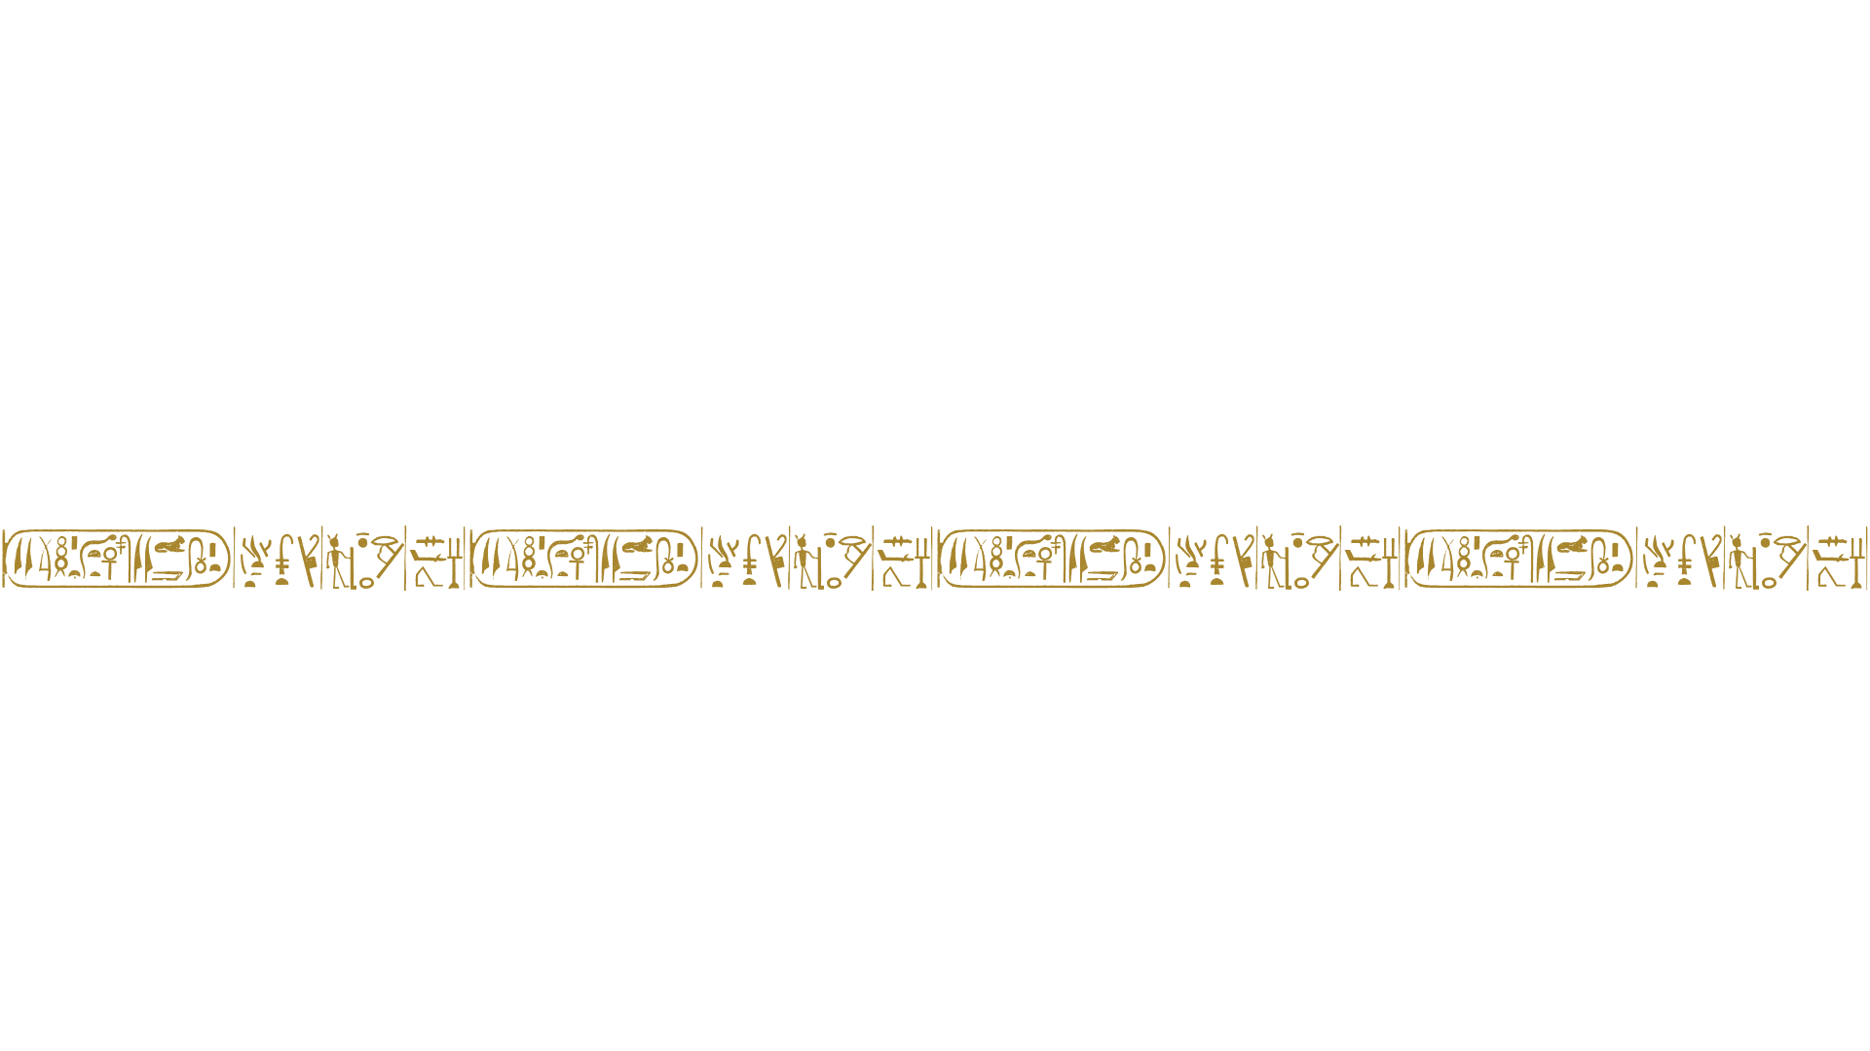
THANK YOU
THOTH — Smart Museum Guide Robot
Questions & Discussion
github.com/MohamedEldairouty/THOTH

